Slide 1
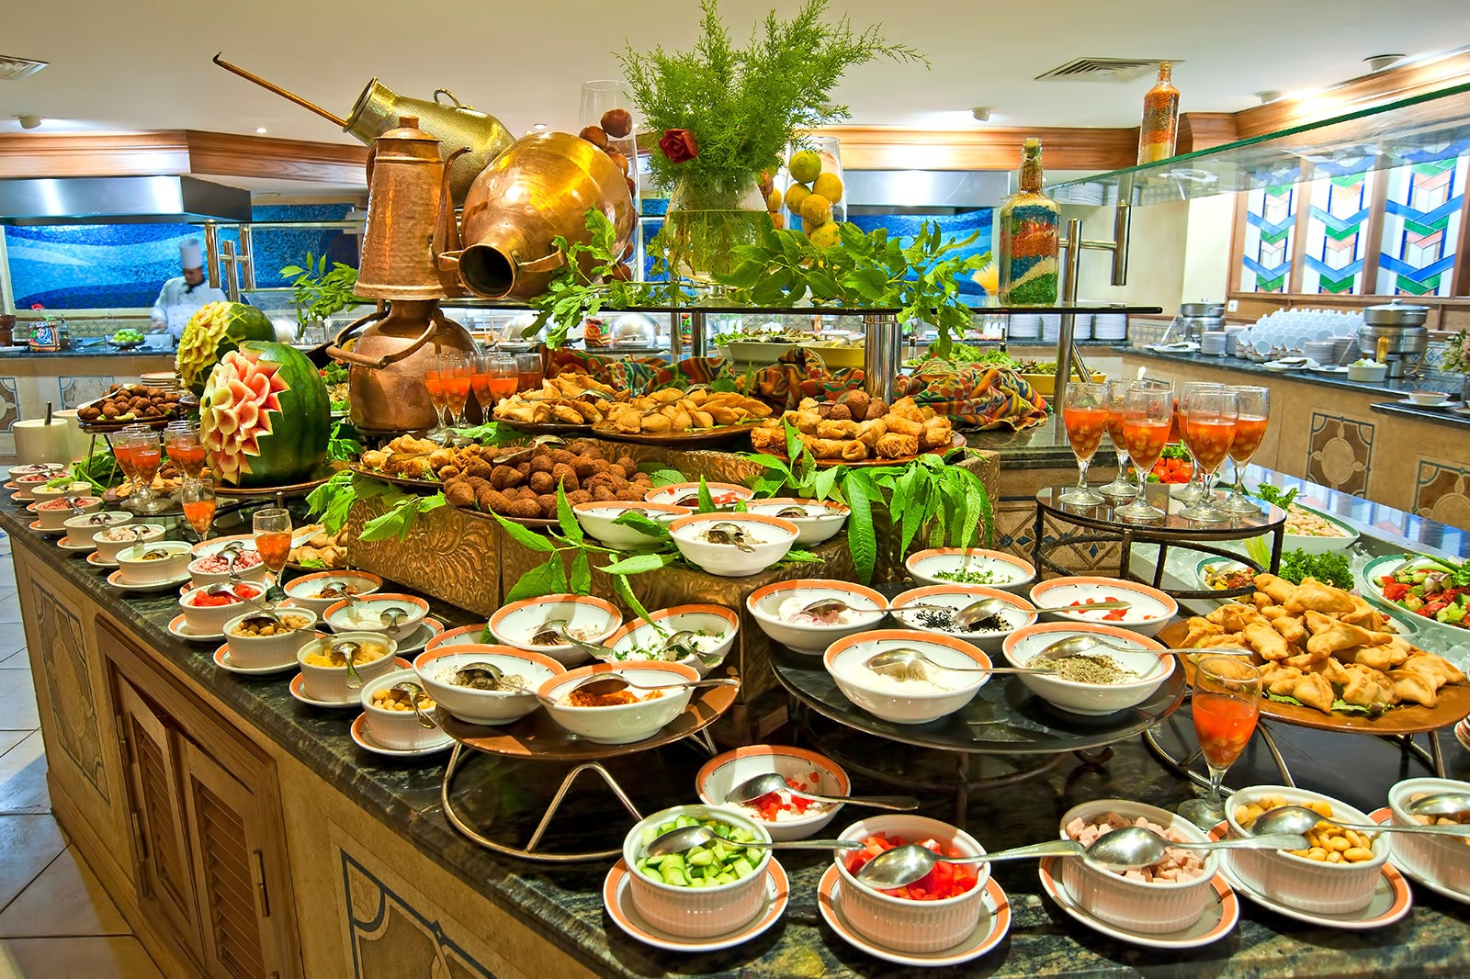
Software for Decreasing Food Waste in Buffet Style Environments
By: Ty Huetter

Slide 2
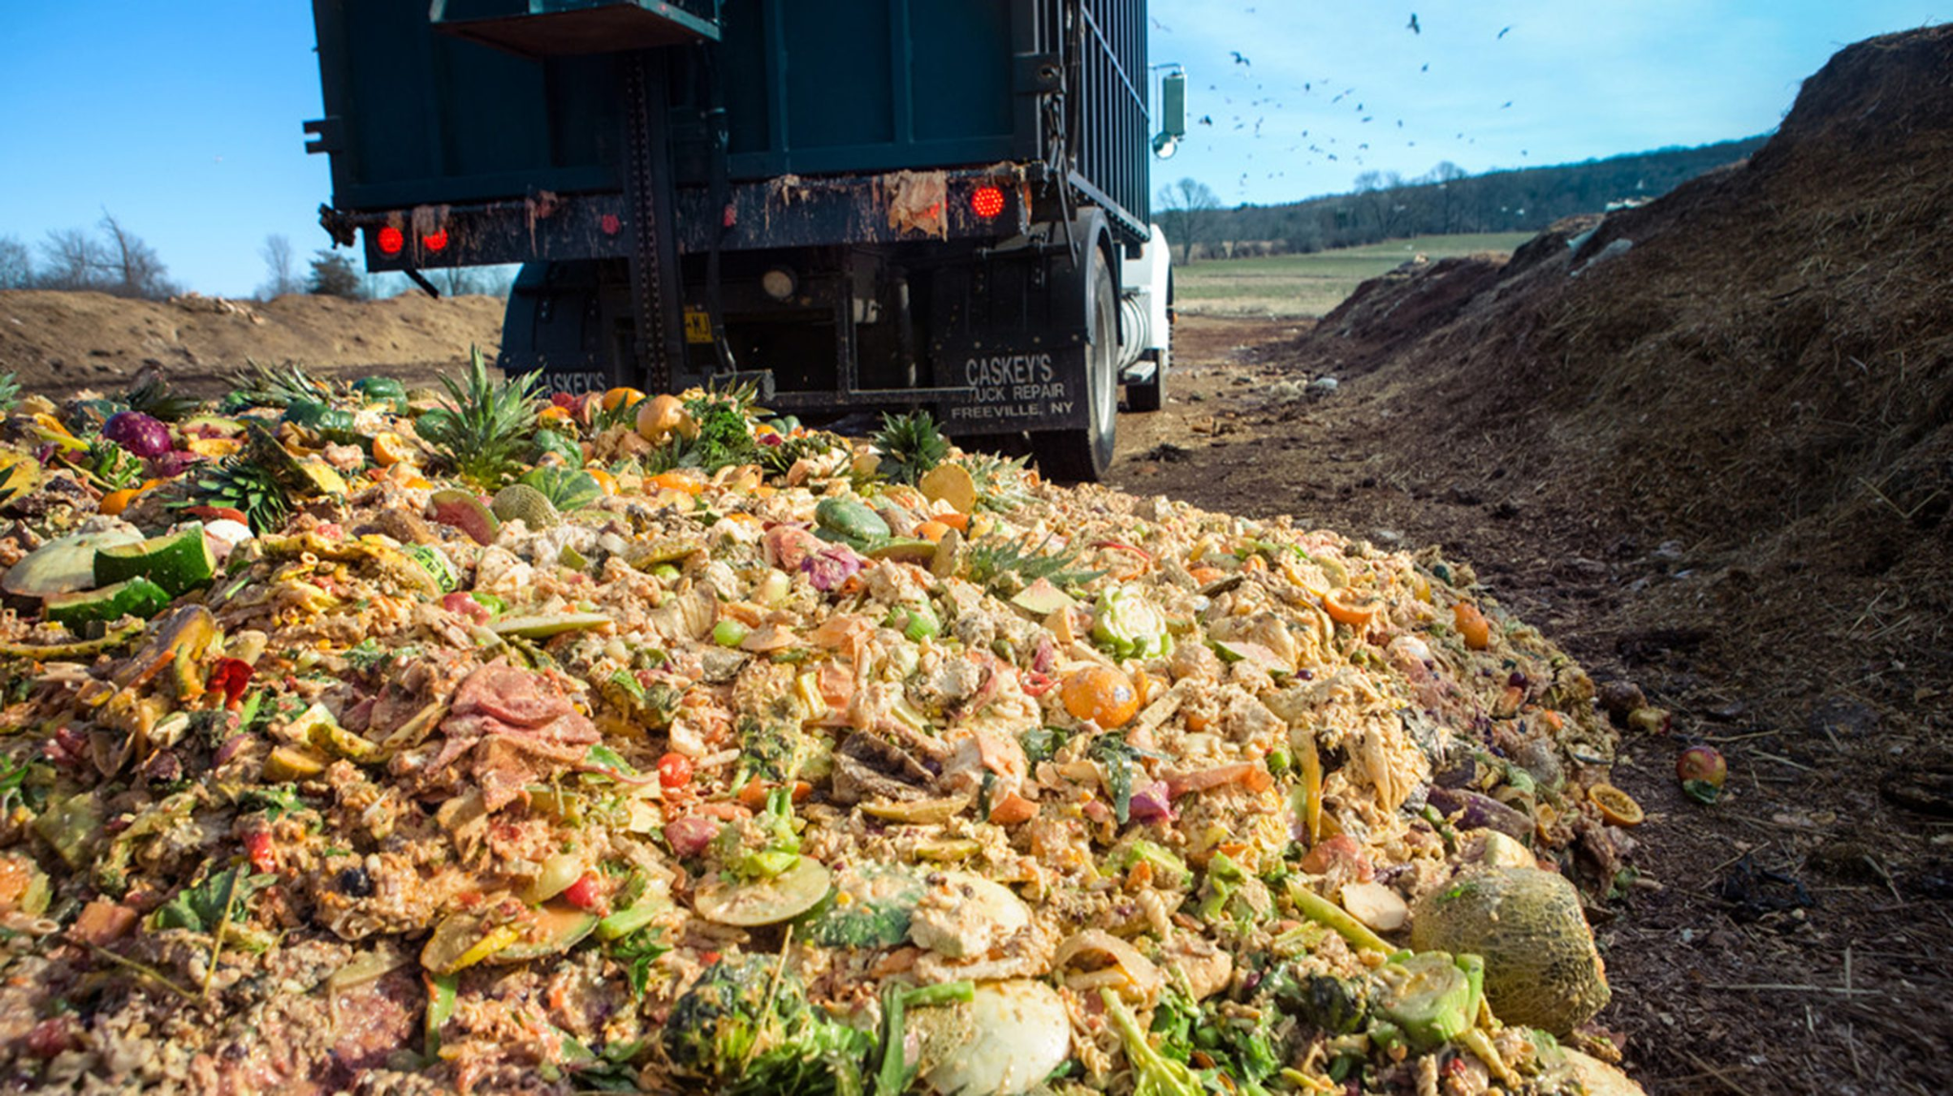
Summary of Findings
Food waste accounts for 108 billion pounds per year.
540,000 tons per year from University halls.
Detrimental environmental effects, such as methane emission, mass animals killed, habitats destroyed.
Economic effects, millions-billions dollars lost every year to over preparation of food.

Slide 3
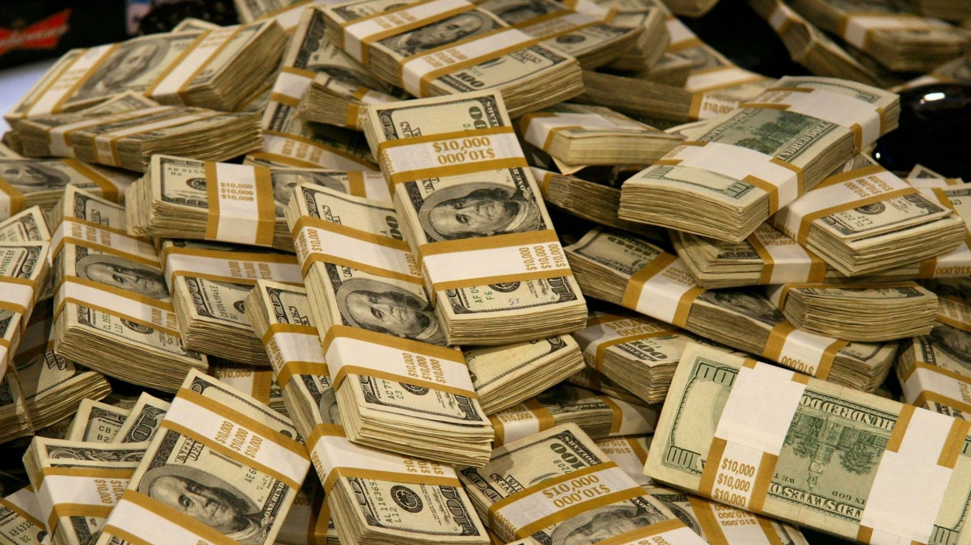
Real-World Application
The program could reduce food waste, which will directly decrease the environmental impacts, economic impacts.
The program could also make University Meal plans cheaper, because less food wasted = less money to compensate for the wasted food.

Slide 4
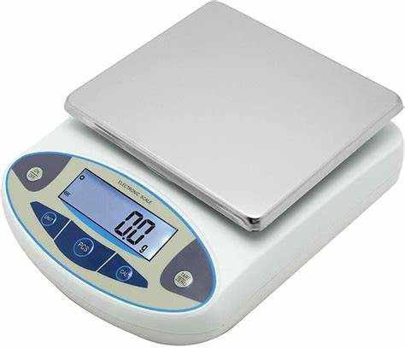
Design Approach
The device would be able to store specific weights at certain times throughout the day (for example, if the food weighs 1.3 lbs at the start of the day, the device would calculate every time the weight decreases and increases until the closing time of the restaurant). If the weight increases, that tells the user that food was added back into the container, and if the weight decreases, that tells the user that food was taken from the container. Then the scale can be set to record the final weight at a specific time, preferably when the buffet closes and before the cooks clean the containers. This will ensure that the scale does not record the weight, which would be close to 0, after the cooks dump out and clean the container.
This device could reduce the amount of food taken by customers because
it would force the customers to be more mindful of what they eat.

Slide 5
Coding Steps
Read weight from a digital scale
Record the data at what time the weight increased or decreased
When the weight decreases
Add that value to food_taken weight
When the weight increased
Add that value to the food_made weight
Make a food counter that will track how many times a specific food gets taken
Counter += 1 when food decreases
Record food weight at the end of open period (when food is replenished and not thrown out)
Compare total food made to total food wasted
Optional input for kitchen to record how much food they threw out in preparation
Math for how much money could have been saved if food was not made
Print statement that includes how much food was made, taken, wasted, and the most taken food

Slide 6
Pseudocode
CIS129_FinalProject/Pseudocode at main · tyhuetter/CIS129_FinalProject

Slide 7

Open Questions
The biggest question I have is how well this system will actually track the weight changes within the food containers.
I still do not know how I will do the math for how much weight is lost or gained for containers, but I in the last couple of days I will figure it out.

Slide 8
Citations
Kundamal, R. (2023, January 17). The unsustainability of Buffet Food Waste. Global Research
and Consulting at Berkeley (GRC). https://grc.studentorg.berkeley.edu/the-unsustainability-of-buffet-food-waste/
Leal Filho, W., Lange Salvia, A., Davis, B., Will, M., & Moggi, S. (2021). Higher Education and
food waste: Assessing current trends. International Journal of Sustainable Development &amp; World Ecology, 28(5), 440–450. https://doi.org/10.1080/13504509.2020.1865474
Learn Python. (2023, August 15). How To Read Data From Digital Scale In Python. YouTube.
https://www.youtube.com/watch?v=x_Z0H7BC5aY&t=347s
Murti, L. (2023, December 14). The cost of convenience: College meal plans. Covering Poverty.
https://coveringpoverty.uga.edu/the-cost-of-convenience-college-meal-plans/
Mahalias, I. (2024, December 5). What is Django used for? (5 use cases). PLANEKS.
https://www.planeks.net/what-is-django-used-for/
Wu, C.-M. E., & Teng, C.-C. (2022). Reducing food waste in buffet restaurants: A corporate
management approach. Foods, 12(1), 162. https://doi.org/10.3390/foods12010162

